Slide 1
BDBA
New Website Proposal
Prepared by: Keith Brown
January 2022

Slide 2
Issues with current Website
The platform on which the website was initially built (Drupal version 8) has reached it's end of life
Certain areas of the website when edited generate errors
Links to the new BDBA Facebook site are not saving properly
The site requires an expensive upgrade for the functionality to be operational
The BDBA service provider has advised that he cannot continue to support the website, a new service provider will be required
Drupal is complex - A realistic solution is to consider a simpler platform
Does the BDBA require an operational website? What information are our members seeking?

Slide 3
Proposal
Migrate to a platform developed and supported by Bowls Australia
Must be mobile friendly
Must be a secure site
Provide sufficient functionality for our members to easily find information
Allow multiple administrators to post details like news items, events, results, pictures, selections, in a timely manner
No requirement to provide financial functionality. The BDBA already has financial packages in place.
Build a demo website and seek feedback from clubs and members regarding the suitability of the platform

Slide 4
Home Page of the Current Website

Slide 5
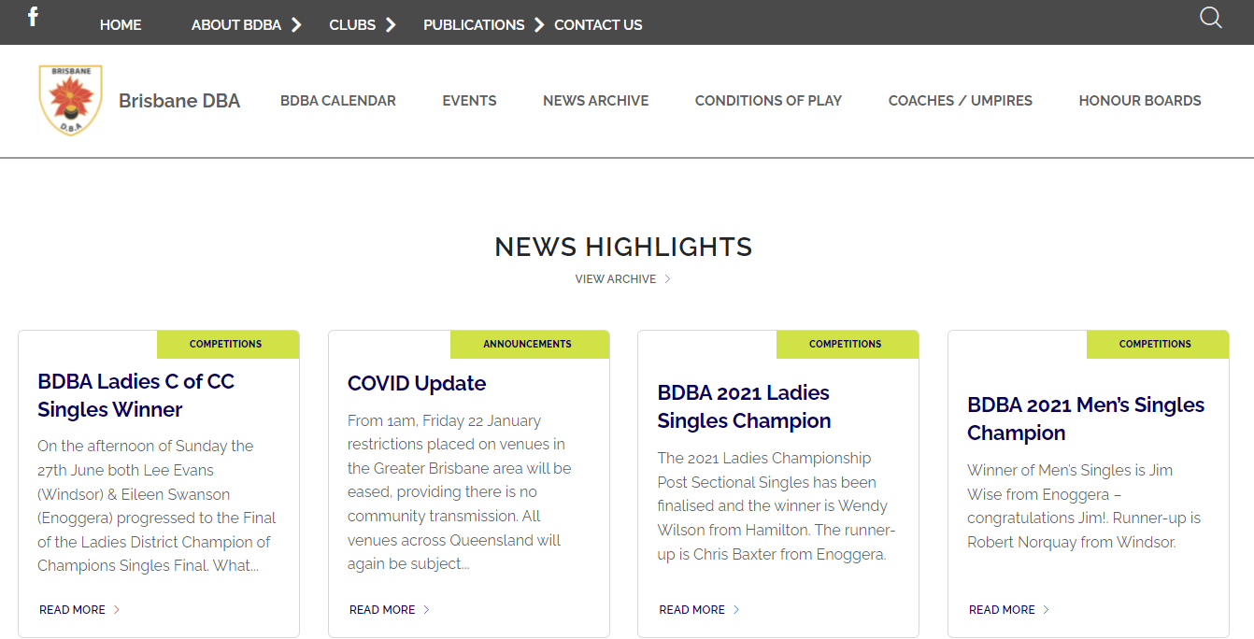
Home Page of the new Website

Slide 6
Multi-Levels Menus
Top Header
Primary

Slide 7
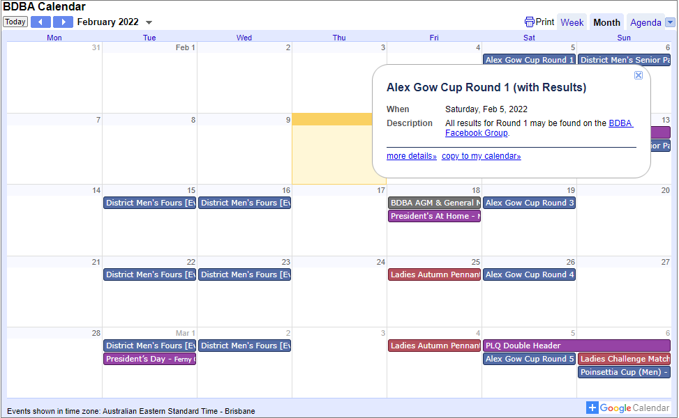
Online BDBA Calendar
1. Click on “Alex Gow Cup Round 1
2. Click on Facebook link

Slide 8
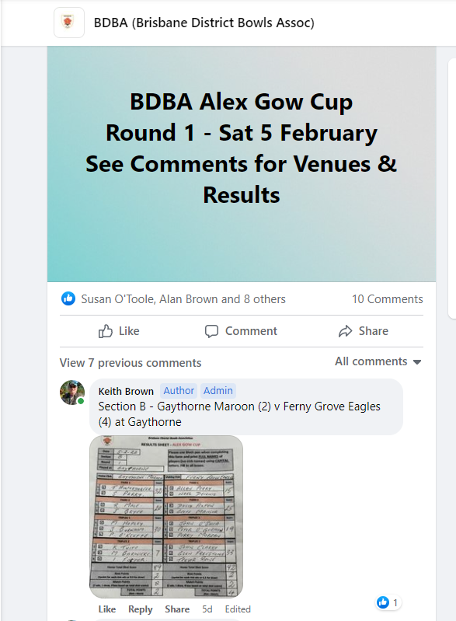
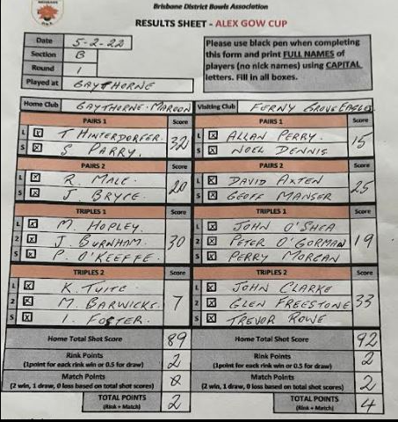
Online BDBA Calendar – Facebook Link
-

Slide 9
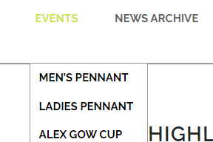
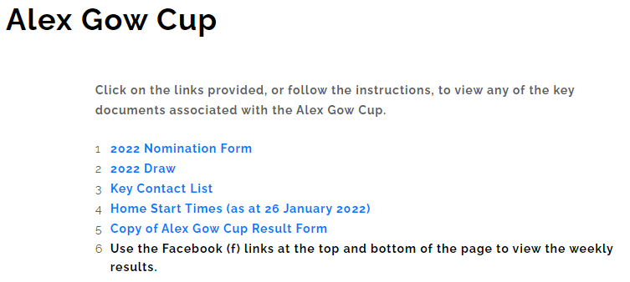
Sample of “Events” Primary Menu

Slide 10
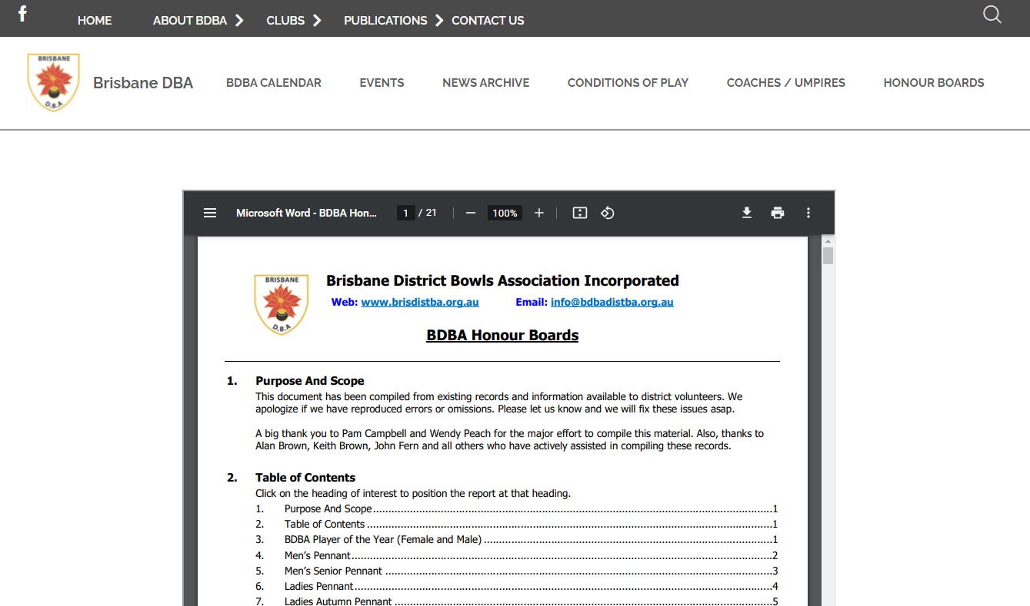
Honour Boards

Slide 11
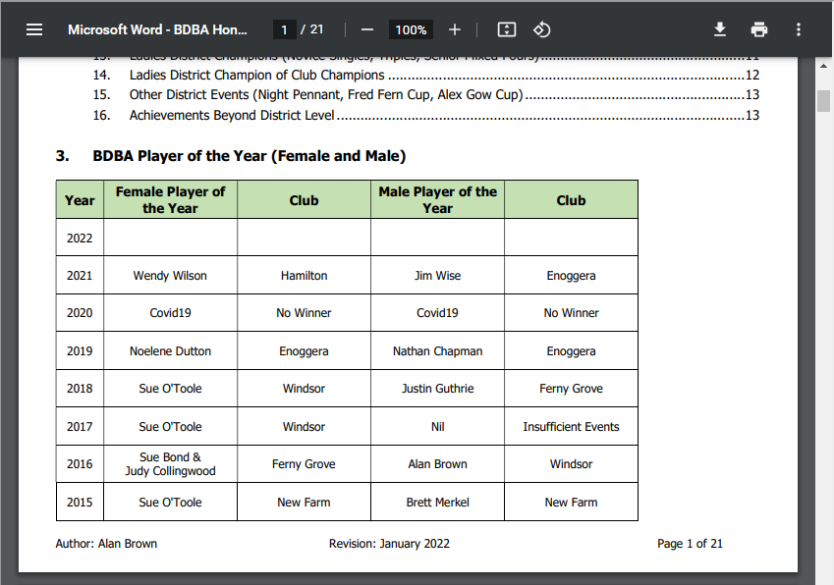
Honour Boards

Slide 12
Next Steps
Finish the build of the new Website
Negotiate with BA the annual fees for the platform
Develop a migration plan for moving data from the old site to the new
Find members to perform the “Administration” roles
Discuss with the current service provide how the site may be decommissioned

